Slide 1

Vel Tech Rangarajan Dr. Sagunthala R&D Institute of Science and Technology
School of Computing
Department of Computer Science and Engineering (Data Science)
10211DS224 / FULL STACK APPLICATION DEVELOPMENT (JAVA)
FINAL PROJECT REVIEW : MILESTONE PROJECT
Date:06-05-2026
Event Ticket Booking System
SDG: SDG 3 React JS Based Event Ticket Booking System
Presented By:
S.VINOTHA – VTU24362 Reg.No. 23UEDC0068
Courses Handling Faculty:
Dr.P. Durga Devi / Assistant Professor/CSE(DS)

Slide 2
INTRODUCTION
1
Event booking systems play a vital role in managing reservations efficiently. Many traditional systems rely on manual processes, which can lead to delays and errors. This project aims to provide a simple and user-friendly web-based solution.Users can view event details and book tickets online easily. The system improves accessibility and reduces manual effort, ensuring a smooth and fast booking experience.The application is built using modern web technologies such as React JS. It demonstrates the real-world implementation of front-end development concepts, including component-based architecture, state management, and form validation.
2
3
4
5
6
7
8
9

Slide 3
PROBLEM STATEMENT
1
In many event management scenarios, the booking process is manual or poorly organized, making it difficult for users to access event information quickly and efficiently. Manual booking methods often result in errors, delays, and overall inefficiency.Additionally, there is no centralized system to manage event reservations effectively. Existing systems often lack user-friendly interfaces, making them difficult to use. Tracking bookings and maintaining records also becomes a challenging task.Therefore, there is a need for an automated and reliable ticket booking system that can streamline the reservation process. The proposed system aims to improve efficiency, ensure accuracy, and enhance the overall user experience.
2
3
4
5
6
7
8
9

Slide 4
OBJECTIVE(S)
1
The main objective of this project is to design and develop a user-friendly web-based ticket booking system for internal department events using React JS.
To provide an easy platform for users to view event details
To enable online ticket booking with a simple and interactive interface
To reduce manual effort and minimize booking errors
To implement form validation for accurate user input
To ensure real-time updates of available tickets
To improve efficiency and speed of the booking process
To enhance user experience with a responsive design
To demonstrate the use of modern web technologies like React JS
2
3
4
5
6
7
8
9

Slide 5
PROPOSED SYSTEM
The proposed system is a web-based application designed to simplify the event booking process. It provides an efficient and user-friendly platform for managing event reservations.
A web-based application for event ticket booking
Users can easily view event details such as date, time, venue, and ticket price
Secure sign-in system before booking tickets
Interactive booking form to collect user information
Real-time booking summary display after submission
Simple, clean, and responsive user interface
Reduces manual work and minimizes errors
Ensures a faster and more efficient booking process
1
2
3
4
5
6
7
8
9

Slide 6
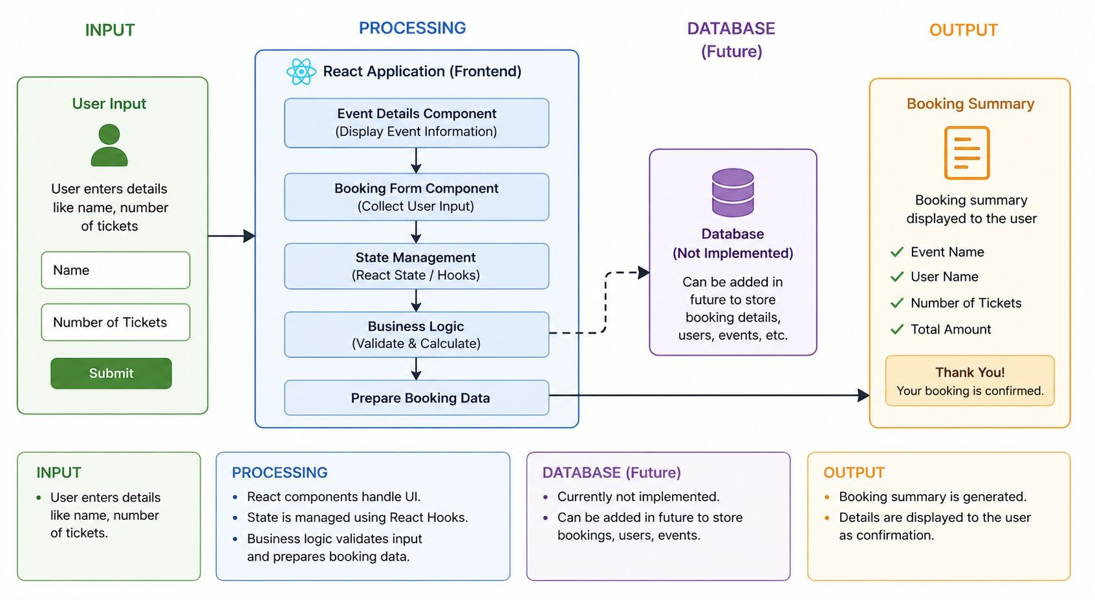
PROPOSED SYSTEM ARCHITECTURE
1
2
3
4
5
6
7
8
9

Slide 7
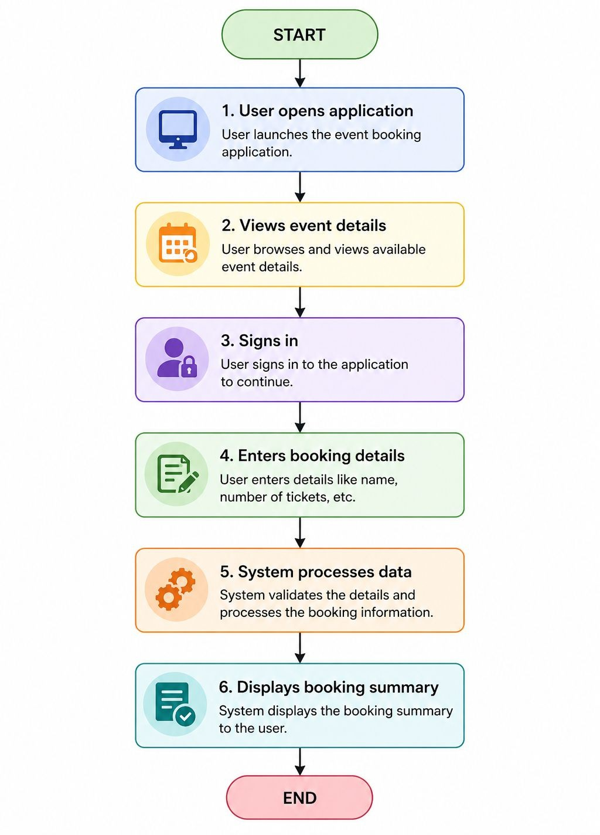
WORKFLOW
1
2
3
4
5
6
7
8
9

Slide 8
TECHNOLOGIES USED
Frontend:
HTML, CSS, JavaScript
Backend:
Java,SpringBoot
Database:
MySQL
Tools:
Spring Boot
Hardware/Software Requirements:
Browser, InternetConnection
Web Browser (Chrome, Edge, or Firefox)
Node.js (for React setup)
Java JDK (for backend development)
MySQL Server
1
2
3
4
5
6
7
8
9

Slide 9
MODULE DESCRIPTION
1
Module 1: Event Details
Displays event information like name, date, and description.
Module 2: User Authentication
Handles user sign-in through a modal interface.
Module 3: Booking Form
Collects user input such as name and ticket count.
Module 4: Booking Summary
Displays final booking details and confirmation.
2
3
4
5
6
7
8
9

Slide 10
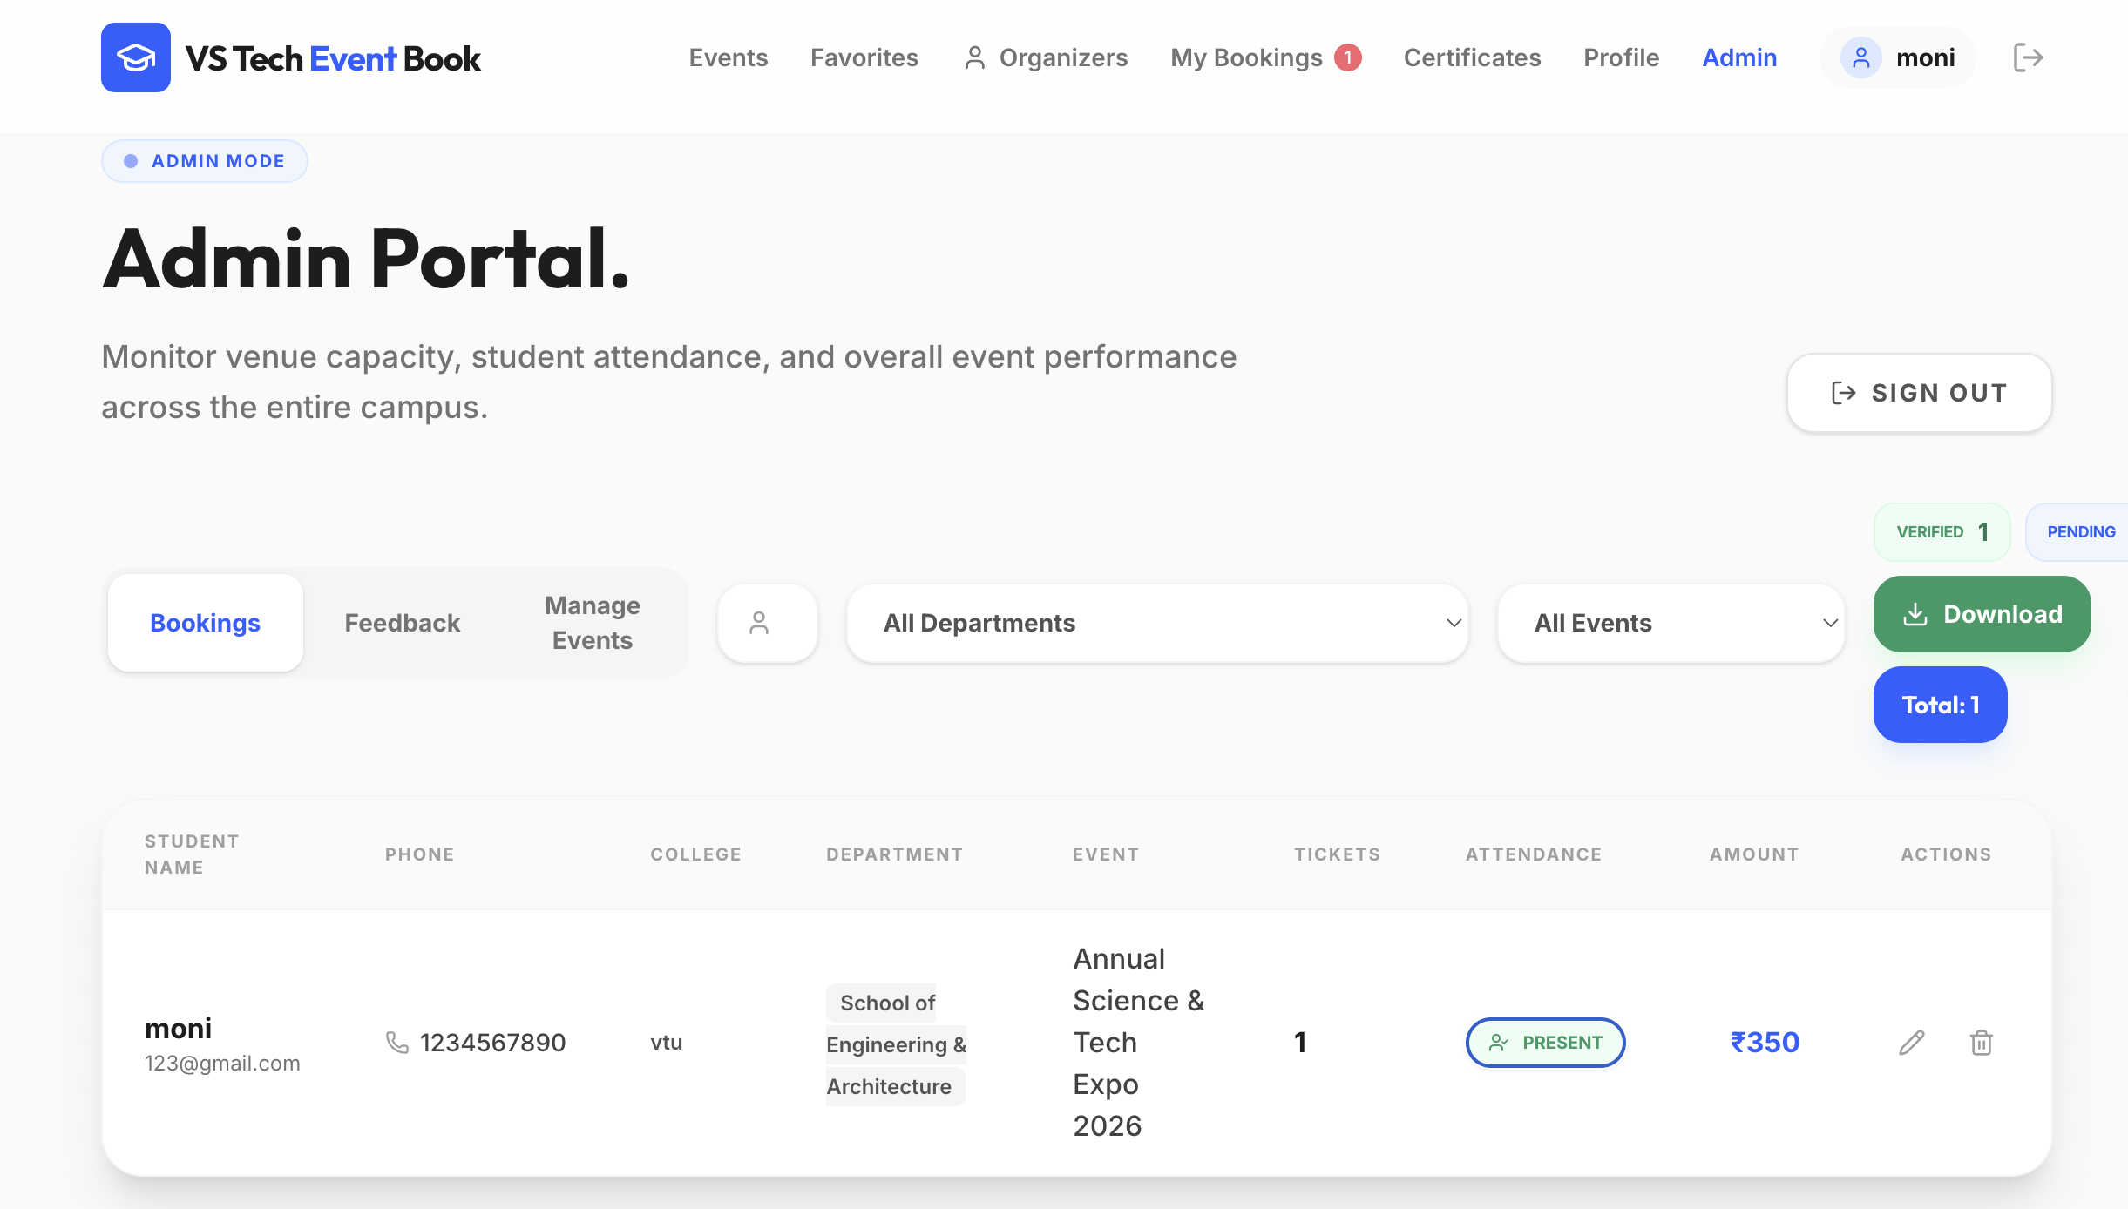
IMPLEMENTATION SCREENSHOTS
1
2
3
4
5
6
7
8
9

Slide 11
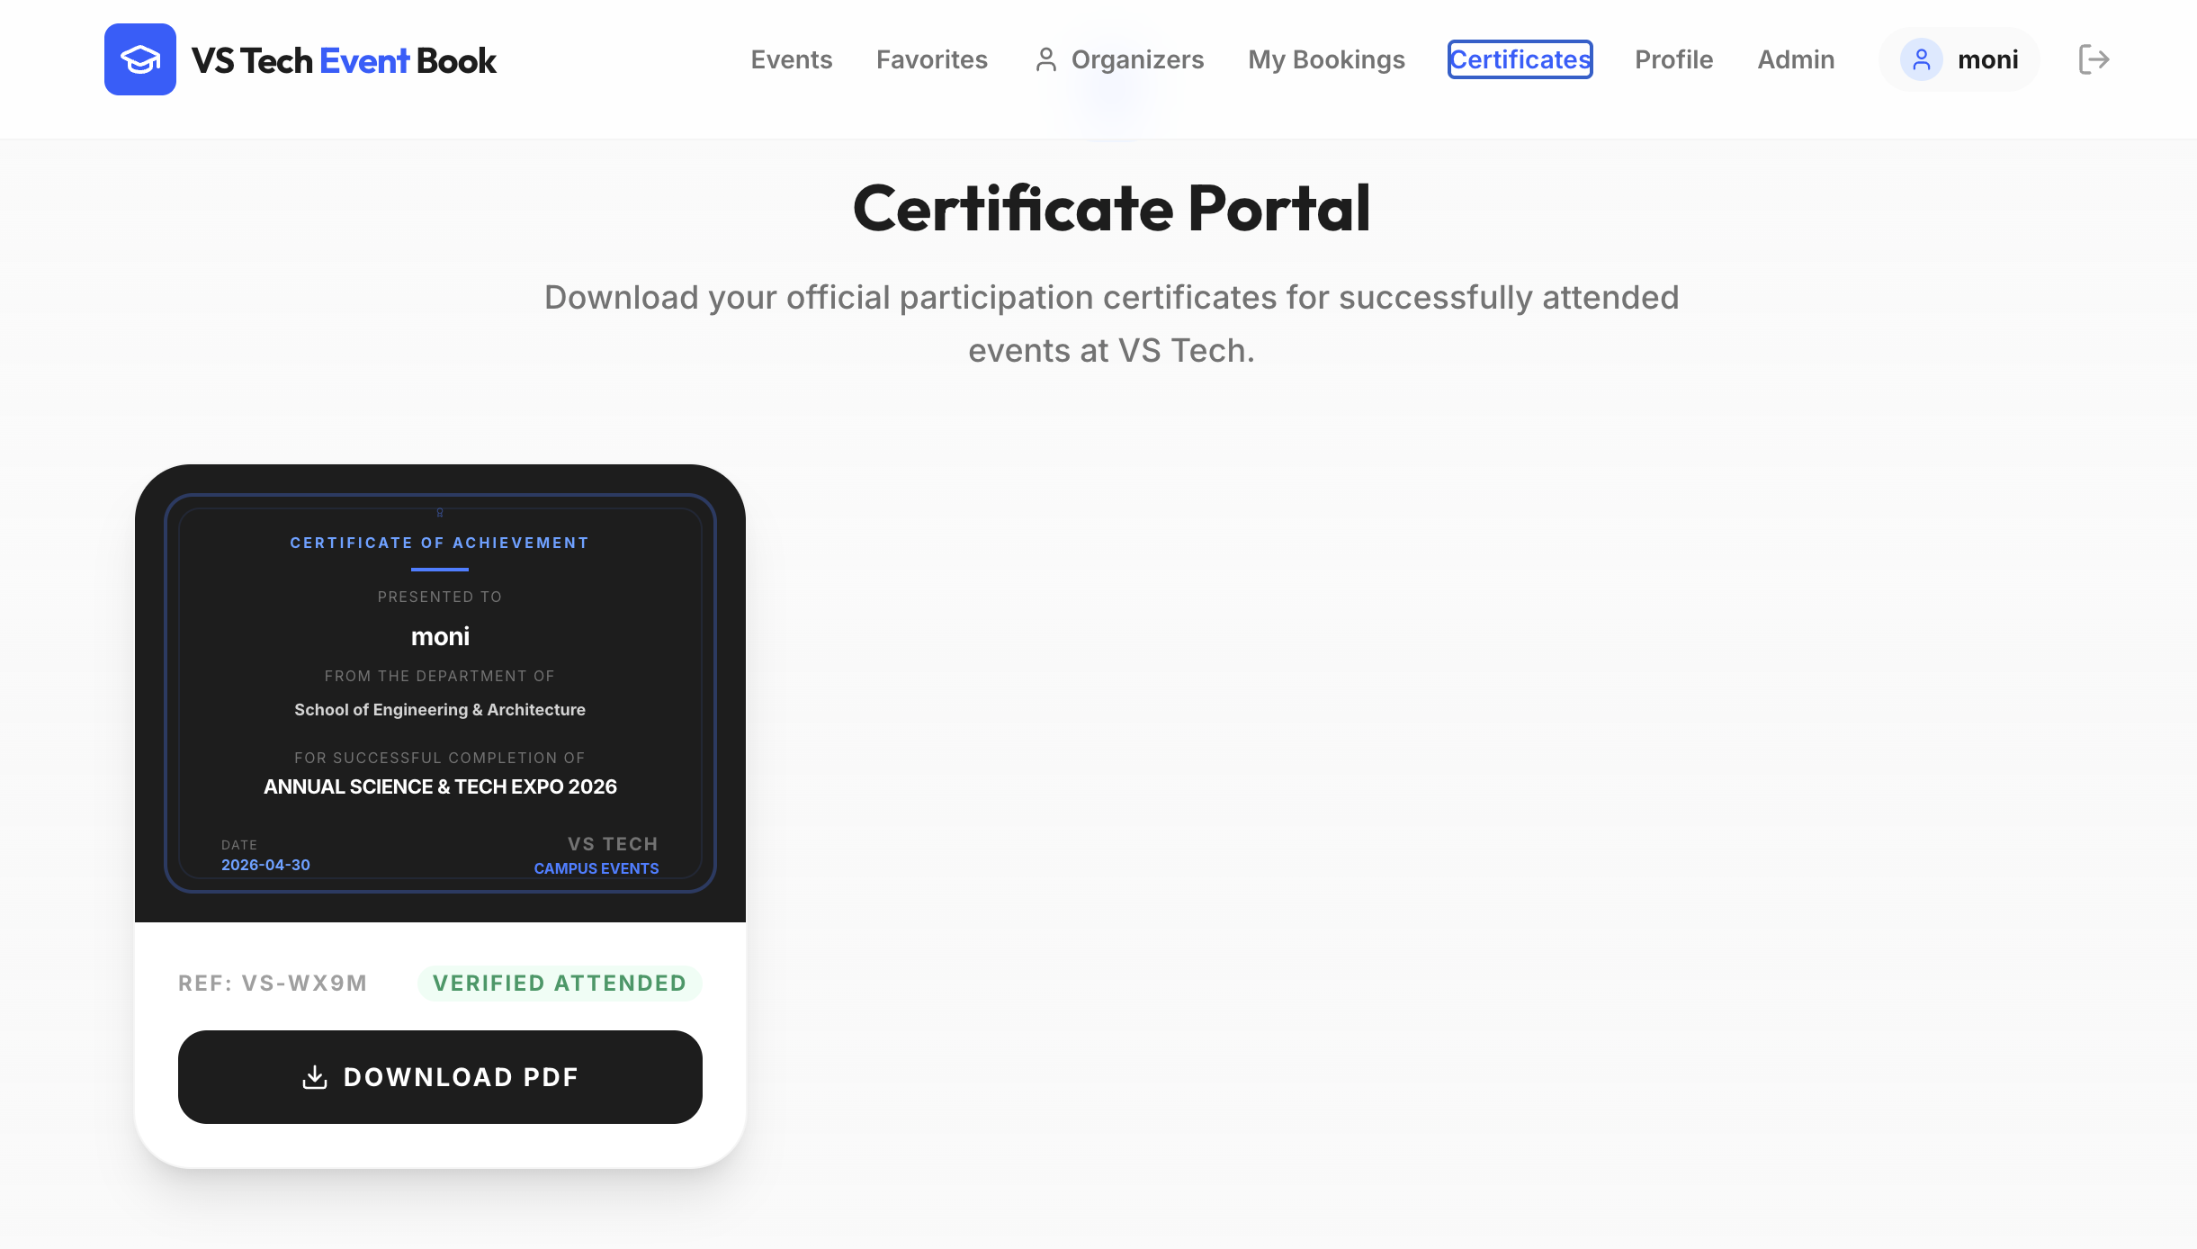
IMPLEMENTATION SCREENSHOTS
1
2
3
4
5
6
7
8(A)
9

Slide 12
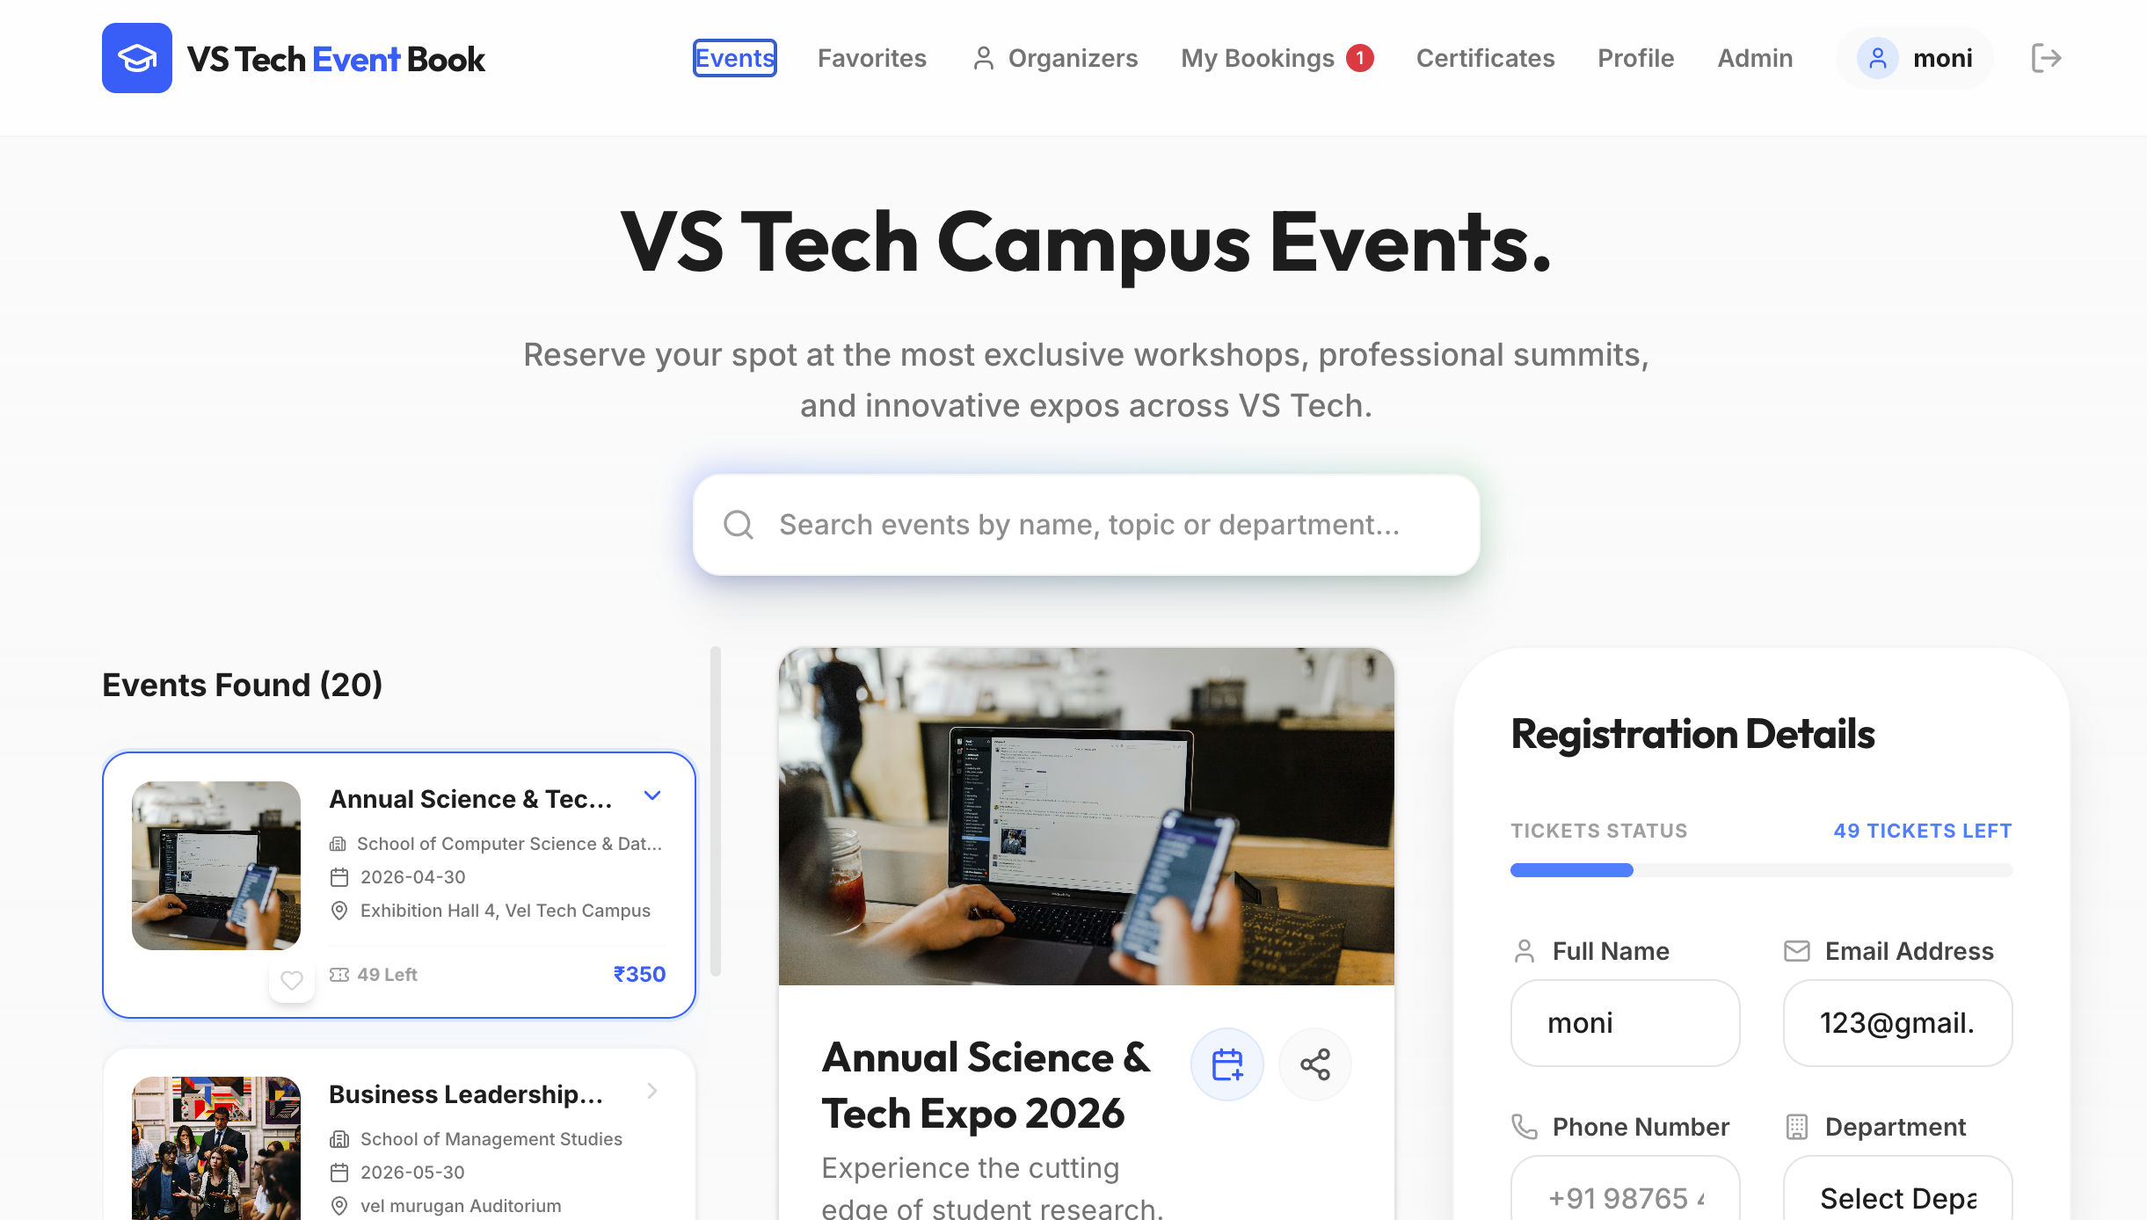
IMPLEMENTATION SCREENSHOTS
1
2
3
4
5
6
7
8(B)
9

Slide 13
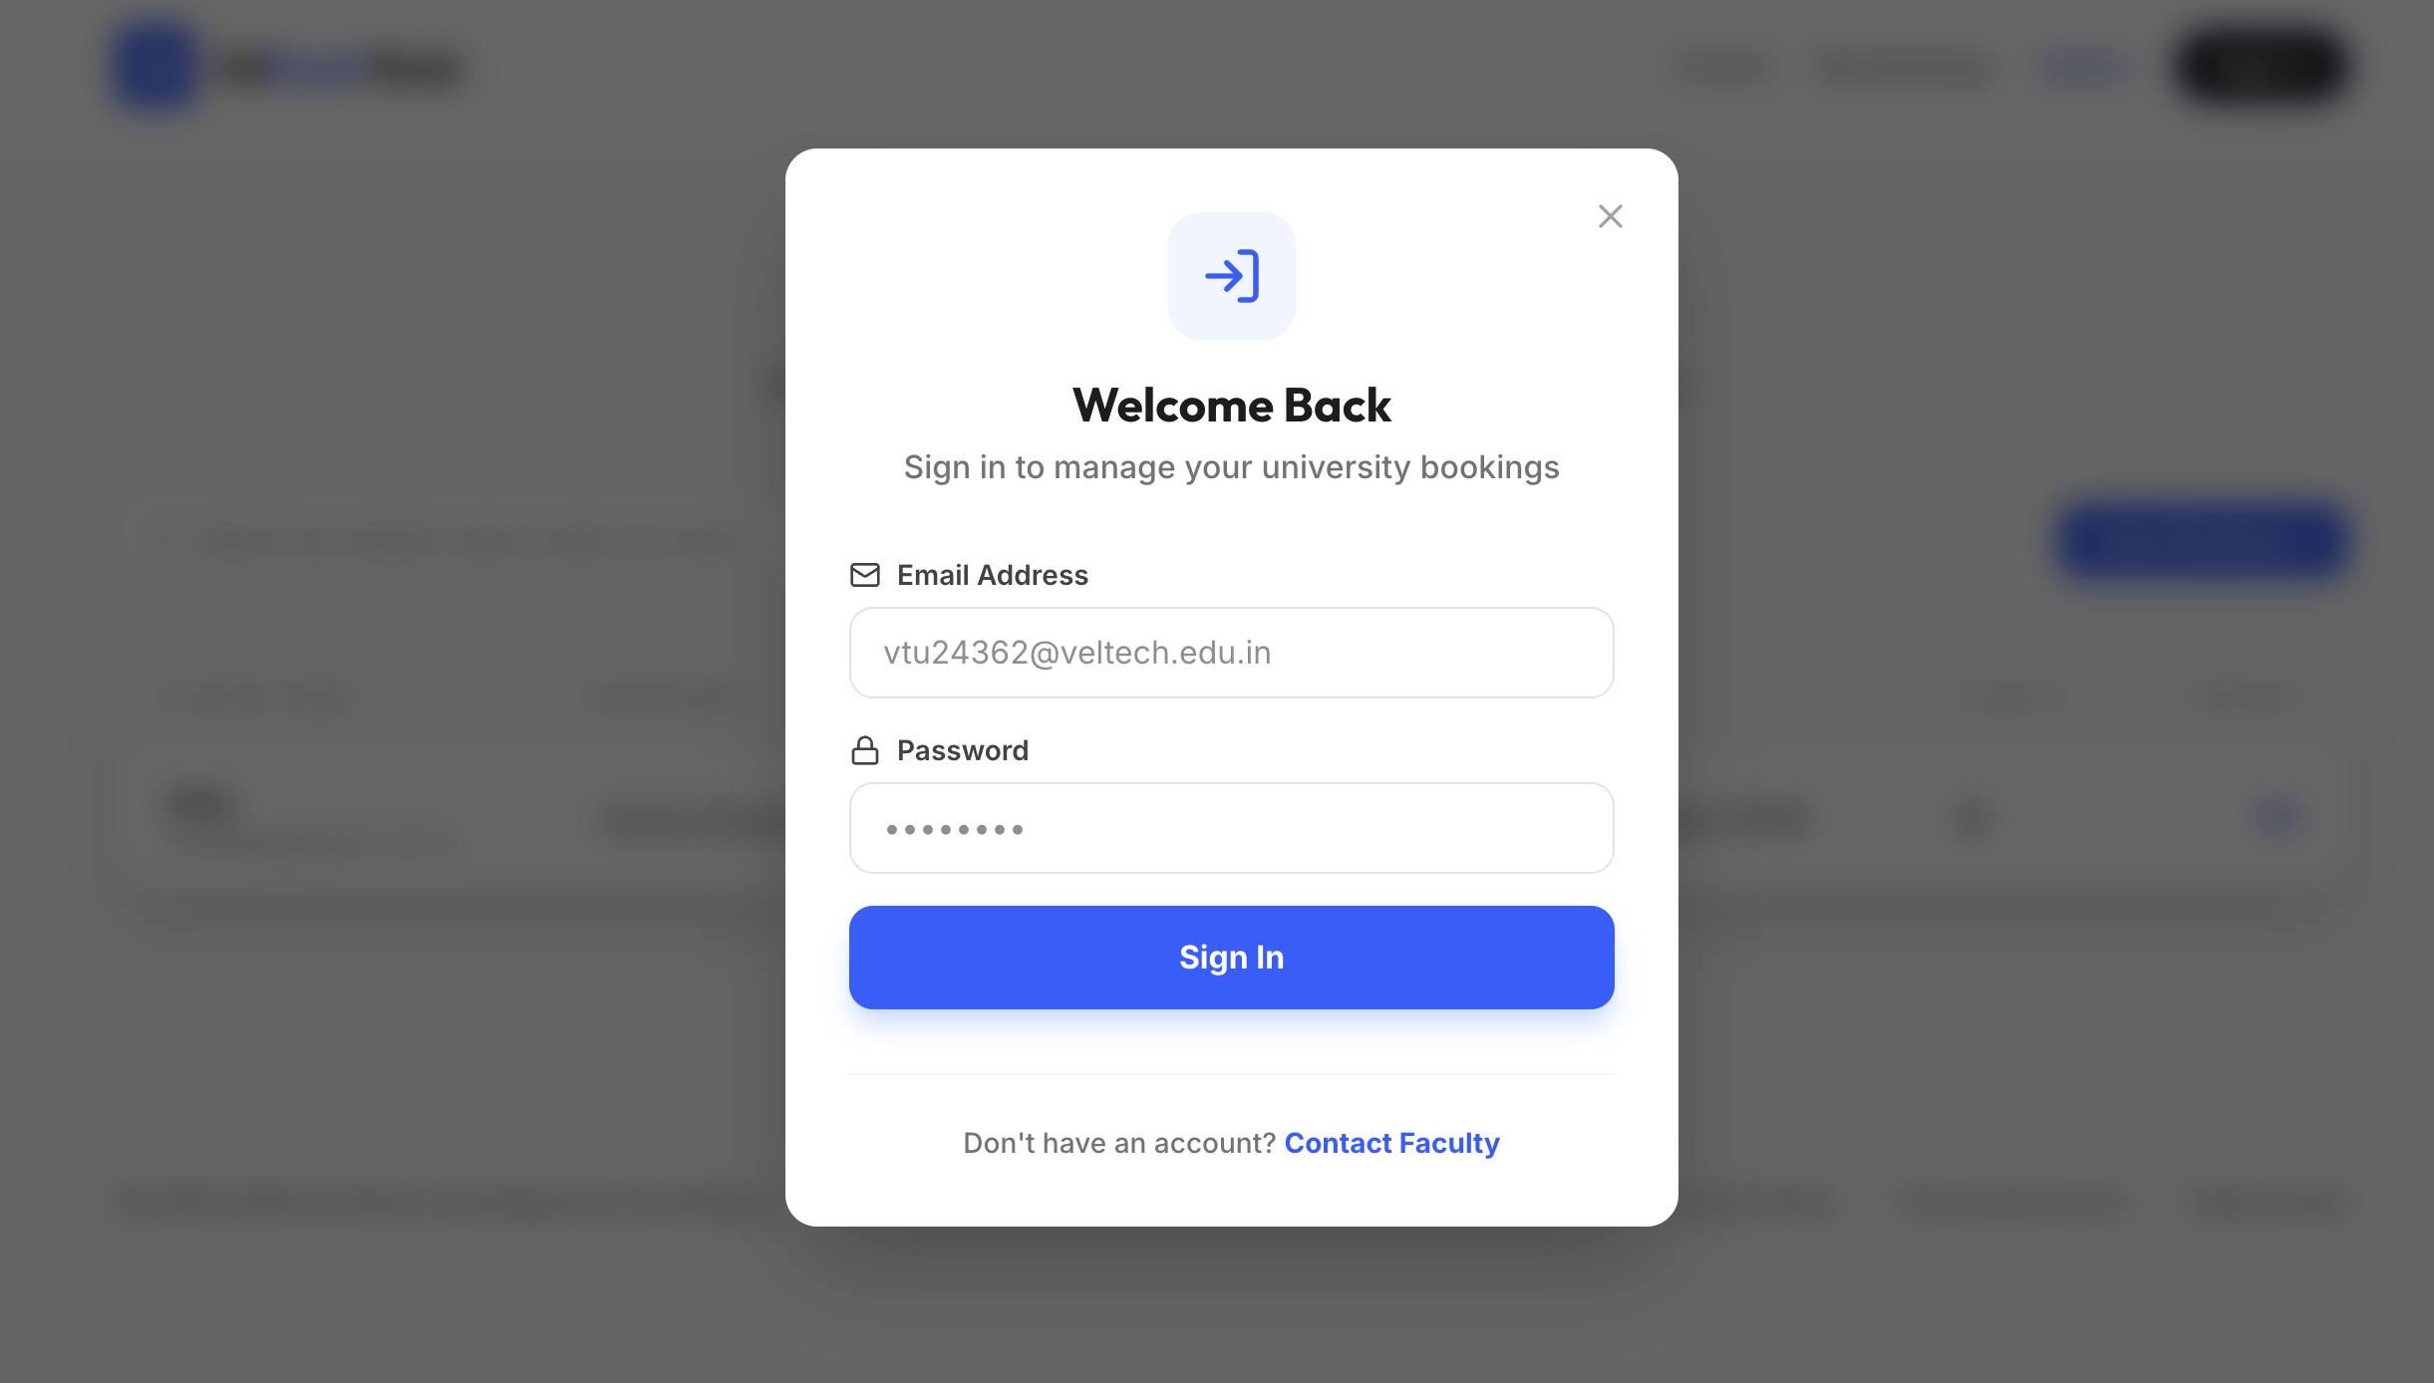
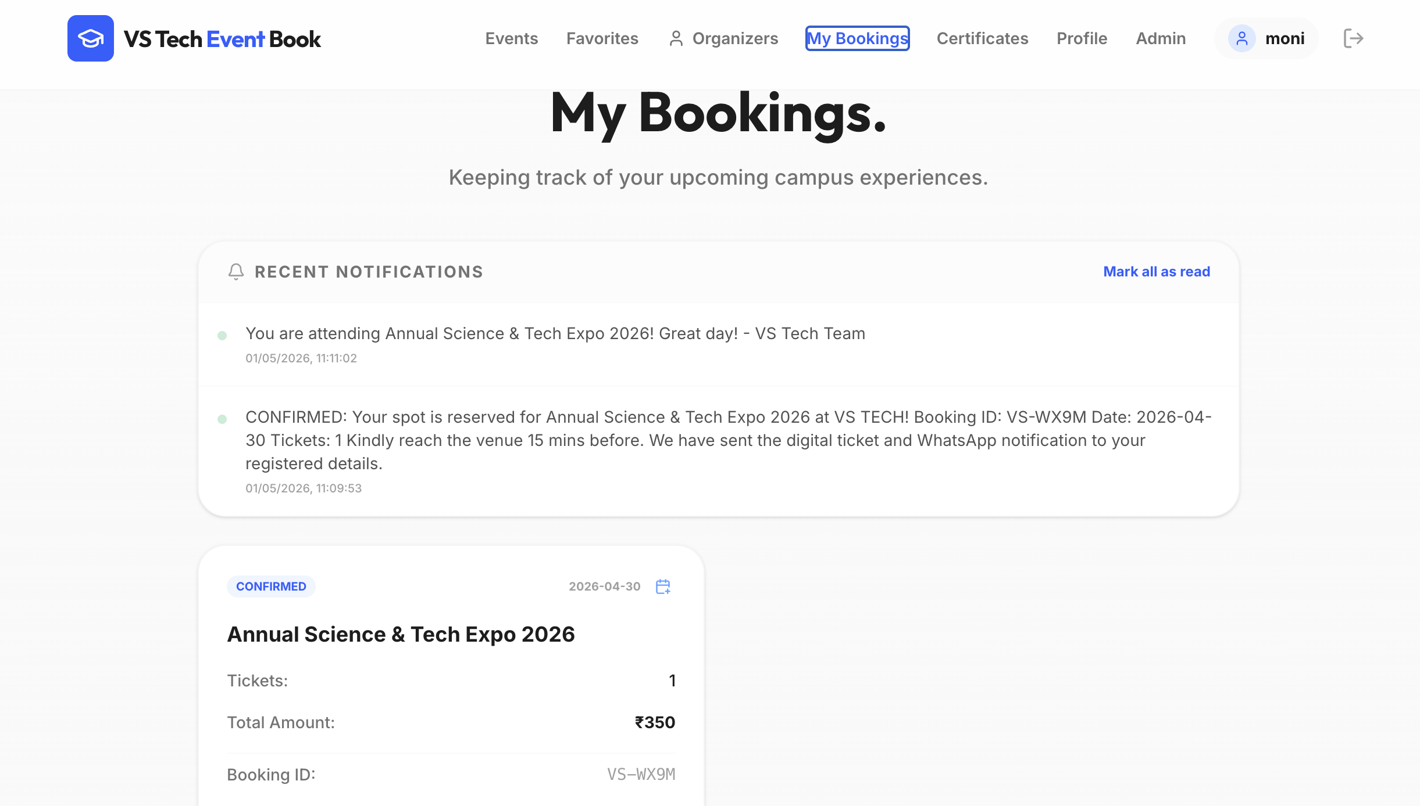
IMPLEMENTATION SCREENSHOTS
1
2
3
4
5
6
7
8(C)
9

Slide 14
ADVANTAGES & LIMITATIONS
Advantages:
Easy to use interface
Reduces manual work
Fast booking process
Modular design
Limitations:
No backend/database
No payment integration
Limited authentication system
1
2
3
4
5
6
7
8
9

Slide 15
Thank You

